Slide 1


Slide 2

Technical Writing Scenarios
What went wrong?

Slide 3

Scenario 1
The Acme Electric Company worked day and night to develop a new current regulator designed to cut the electric power consumption in aluminum plants by 35%. They knew that, although the competition was fierce, their regulator could be produced more affordably, was more reliable, and worked more efficiently than the competitors’ products.
The owner, eager to capture the market, personally but somewhat hastily put together a 120-page proposal to the three major aluminum manufacturers, recommending that the new Acme regulators be installed at all company plants.
She devoted the first 87 pages of the proposal to the mathematical theory and engineering design behind his new regulator, and the next 32 to descriptions of the new assembly line she planned to set up to produce regulators quickly. Buried in an appendix were the test results that compared her regulator’s performance with present models, and a poorly drawn graph showed the potential cost savings over 3 years.
The proposals did not receive any response. Acme Electric didn’t get the contracts, despite having the best product. Six months later, the company filed for bankruptcy.

Slide 4

Scenario 2
As one of the first to enter the field of office automation, Sagatec Software, Inc. had built a reputation for designing high-quality and user-friendly database and accounting programs for business and industry. When they decided to enter the word-processing market, their engineers designed an effective, versatile, and powerful program that Sagatec felt sure would outperform any competitor.
To be sure that their new word-processing program was accurately documented, Sagatec asked the senior program designer to supervise writing the instruction manual. The result was a thorough, accurate and precise description of every detail of the program’s operation.
When Sagatec began marketing its new word processor, cries for help flooded in from office workers who were so confused by the massive manual that they couldn’t even find out how to get started. Then several business journals reviewed the program and judged it “too complicated” and “difficult to learn.” After an impressive start, sales of the new word processing program plummeted.
Sagatec eventually put out a new, clearly written training guide that led new users step by step through introductory exercises and told them how to find commands quickly. But the rewrite cost Sagatec $350,000, a year’s lead in the market, and its reputation for producing easy-to-use business software.

Slide 5

Scenario 3
Joanne supervised 36 professionals in 6 city libraries. To cut the costs of unnecessary overtime, she issued this one-sentence memo to her staff:
When workloads increase to a level requiring hours in excess of an employee’s regular duty assignment, and when such work is estimated to require a full shift of eight (8) hours or more on two (2) or more consecutive days, even though unscheduled days intervene, an employee’s tour of duty shall be altered so as to include the hours when such work must be done, unless an adverse impact would result from such employee’s absence from his previously scheduled assignment.
After the 36 copies were sent out, Joanne’s office received 26 phone calls asking what the memo meant. What the 10 people who didn’t call about the memo thought is uncertain. It took a week to clarify the new policy.

Slide 6


Objectives
This Photo by Unknown Author is licensed under CC BY
What is Technical Writing
Principles of Technical Writing
Components of Technical Writing
Types of Technical Writing
Examples of Technical Reports
Incident/Accident report
This Photo by Unknown Author is licensed under CC BY-SA-NC

Slide 7

Technical Writing
Form of communication that professionals use
to convey information about specialized topics.
Use language and visuals with precision.
Prefer simple direct expression of ideas.
Satisfy the audience’s need for information, not my own need for self- expression.
Hold myself responsible for how well my audience understands my message.

Slide 8
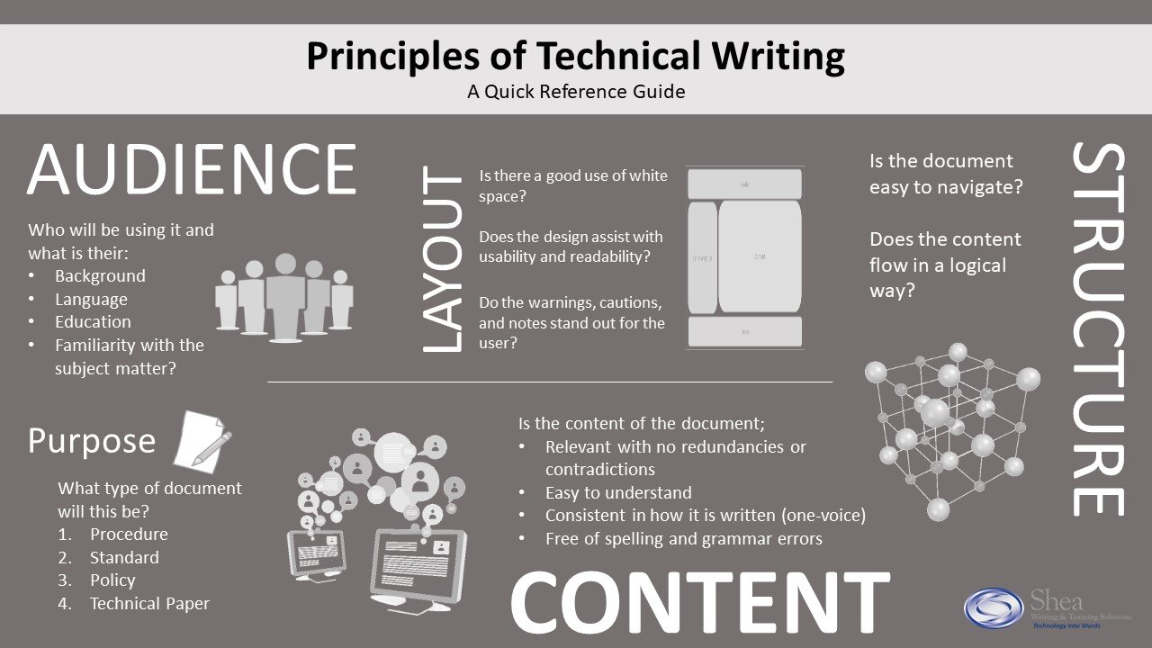
Principles of Technical Writing

Slide 9
Techniques for Technical Writing
Determine requirements of end users
Analyze product samples & communicate with product designers/developers
Minimize use of technical instructions
Write & edit supporting documents
Use diagrams, drawings, & other visual aids
Standardize company processes
Gather feedback & work to implement it in the process

Slide 10
Components of Technical Writing
Clear:
Technical writing conveys information clearly and concisely, leaving little room for interpretation. The language is straightforward and succinct.
Straightforward:
Facts are presented in a direct and to-the-point manner.
Precise:
Technical writing uses specific terminology to precisely describe objects and processes.
Easy to understand:
Technical writers use simple, understandable words and avoid complex terminology.
Denotative:
Technical writing emphasizes literal definitions. By doing so, you avoid misunderstandings caused by the many different connotations of words.

Slide 11
Components of Technical Writing
Detailed:
Technical writing leaves no room for interpretation. For example, a textbook provides the most comprehensive and factual overview of a topic of technical writing.
Very structured:
It needs to have a clear structure so readers can follow along. Readers rely on technical documents for step-by-step instructions.
Easy to skim:
Documents are written with 'skimability' in mind, so audiences can simply scan the text to get the information they need. There is often a table of contents, index, and relevant, descriptive headings.
Problem-solving:
Every technical document is written to solve problems. In these texts, readers learn how to accomplish certain tasks or obtain technical information.

Slide 12
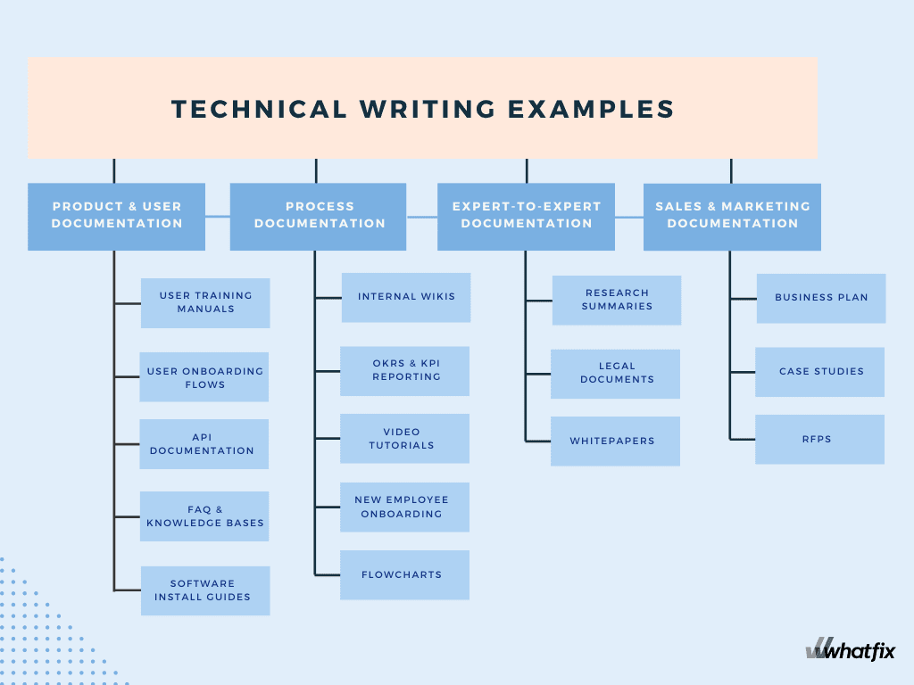
Types -Technical Writing
Instruction manuals/User Manuals
E-learning content
Software installation guides
Product specifications
Product descriptions
Reports
Press releases
Business proposals
Job descriptions
Textbooks
Company documents
Case studies

Slide 13
User Manuals
Software and Technical Documentation
Technical writers in this field are responsible for creating:
Critical to provide product information & support to customers.
A few elements of an effective User Manual are:
Visual aids
Troubleshooting section
Table of contents and index
user manuals
installation guides
troubleshooting guides
It helps users understand and navigate complex software and technical systems.
They must be able to break down complex concepts into clear and concise language, ensuring that users can easily follow instructions and troubleshoot any issues they may encounter.
Comprehensive guide that helps users understand the functionalities and operation of a product.

Slide 14
White Papers and Case Studies
Comprehensive reports that provide detailed information about a specific topic or issue.
Presents facts, analysis, and evidence to support a specific position or recommendation.
Establishing thought leadership
Generating leads
Providing valuable information to potential customers.
Case studies used to inform readers about the effectiveness of a particular product, service, or solution.
Case studies should include detailed information about the problem or challenge faced by the customer, the solution implemented, and the measurable results achieved.
To create a compelling case study, gathering accurate and objective data, using clear and concise language, and including visuals such as charts or graphs to enhance understanding is important.
When showcasing a product, service, or solution, it is important to use a persuasive tone that highlights its unique features and advantages.
Business & marketing often use them to educate and persuade readers about a particular product, service, or solution.
Benefits:
Purpose is to present real-life examples and evidence that demonstrate the positive outcomes and benefits of using the product, service, or solution.

Slide 15
Proposals and Grant Writing
Presents a clear and compelling case for funding & demonstrates a thorough understanding of the project and its potential impact.
Structure:
Tips for writing:
Clearly define your project objectives and how they align with the funder's priorities. It will demonstrate that you have thoroughly researched the funders and understand their goals.
Use concise and persuasive language throughout your proposal. Avoid technical terms and jargon that may confuse or alienate the reader.
Provide compelling evidence for the problem or need your project aims to address. Use statistics, case studies, or expert opinions to support your claims.
Create a realistic timeline that outlines your project's key activities and milestones. It will show that you have carefully thought through the implementation process.
Develop a total budget that accurately reflects the costs of your project. Be sure to justify each expense and explain how it directly supports your objectives.
introduction, problem statement, objectives, methods, timeline, budget, and evaluation plan.
Each section serves a specific purpose to convey the necessary information and convince the reader of the project's worthiness.

Slide 16
Business & Marketing Writing
Focused on communicating information about a company, its products or services, and its marketing strategies to a specific audience.
Includes writing sales letters, press releases, product descriptions, and marketing materials.
Aims to persuade and inform potential customers about the company and its offerings.
Policies and Procedures
Documents, such as employee handbooks or instructional guidelines for a particular task, are easily understood and followed by staff members.
Information must be organized and presented in a logical manner

Slide 17
Ranges from user manuals and FAQs to blog posts and articles.
Require clear and concise language, organizing information in a logical manner, and incorporating visuals or multimedia elements to enhance comprehension.
Research may be required to identify target audience's needs and preferences and incorporating those insights into the content creation process.
Word processing software
Content management systems (CMS)
Screen capture software
Online Content and Documentation
The goal is to provide valuable information in a way that is easily accessible and understandable to the reader.
Tools and Technologies:

Slide 18
Instructional and Training Materials
Technical Reports & Research Papers
Most common; consists of writing user manuals, online tutorials, and training guides.
A wide variety of Instructional and Training Materials are:
User manuals
Online tutorials
Training guides
Video tutorials
Interactive simulations
Aims to provide clear and concise instructions on using a product or completing a task.
Technical reports and research papers are two common types of technical writing that are widely used in various industries and academic fields.
Reports used in engineering, science, and technology fields; research papers are common with academic research and scholarly publications.
Strong understanding of the subject matter,
Clear and concise language and
A logical structure to convey information and support arguments or conclusions effectively.
Used to communicate complex information, findings, and analysis to a specific audience.
Both require:

Slide 19
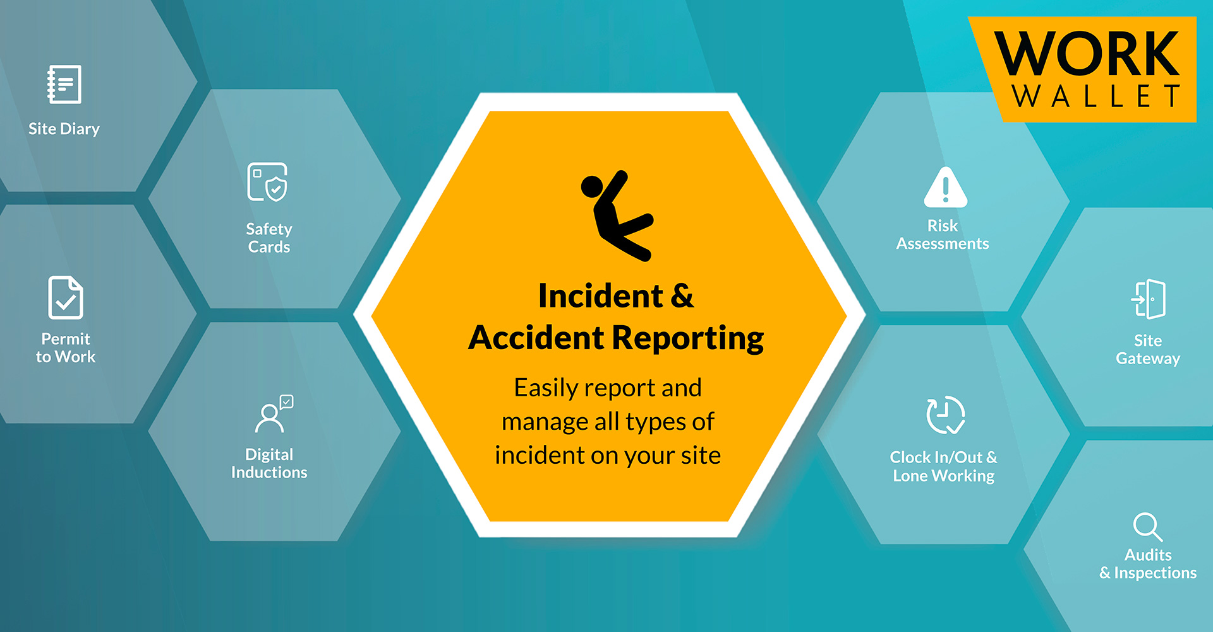
Incident/Accident Report
This report records worksite events, including near misses, injuries, and accidents.
Entails documenting all the facts related to incidents in the workplace.
Incidents are generally accidents or events that cause injuries to workers or damages to property or equipment.
Additionally, incidents also cover near misses-events that have enough potential to cause harm.

Slide 20
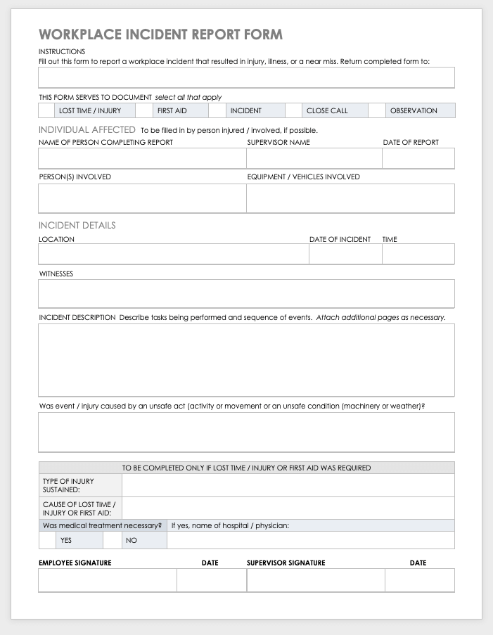
Workplace Incident Report Form Template

